Slide 1
Lesson objective
Title: Frequency tables
Aim – be able to:
Calculate averages from a frequency table
Plan:
- review terminology
Averages

Slide 2
Mean: the average of the given numbers and is calculated by dividing the sum of given numbers by the total number of data points.
Median: is the "middle" of a sorted list of numbers.
Mode: the most frequent number.
Frequency: the number of times a particular value for a variable (data item) has been observed to occur.
Outlier: an observation that lies an abnormal distance from other values in a random sample from a population.
Sample: a piece of information you get from a fraction of a population.
Census: is a study of every unit, everyone or everything, in a target population.

Slide 3
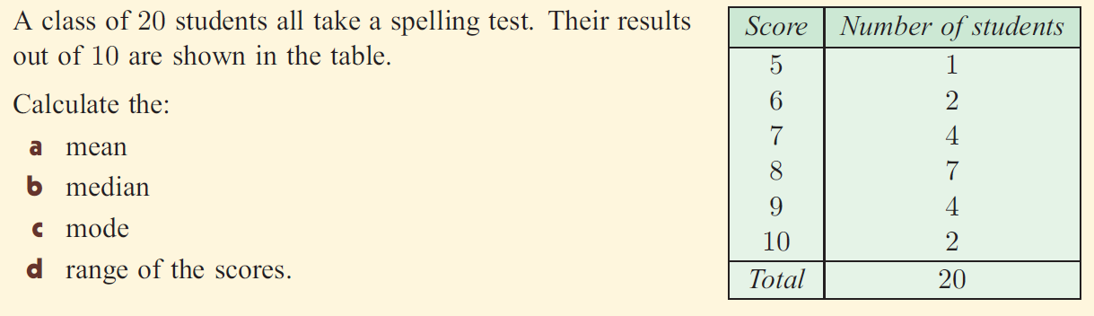
LO: TBAT calculate the averages from a frequency table.

Slide 4
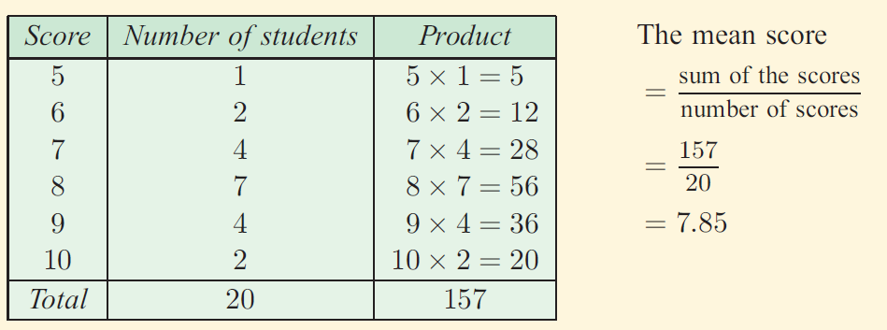
LO: TBAT calculate the averages from a frequency table.

Slide 5
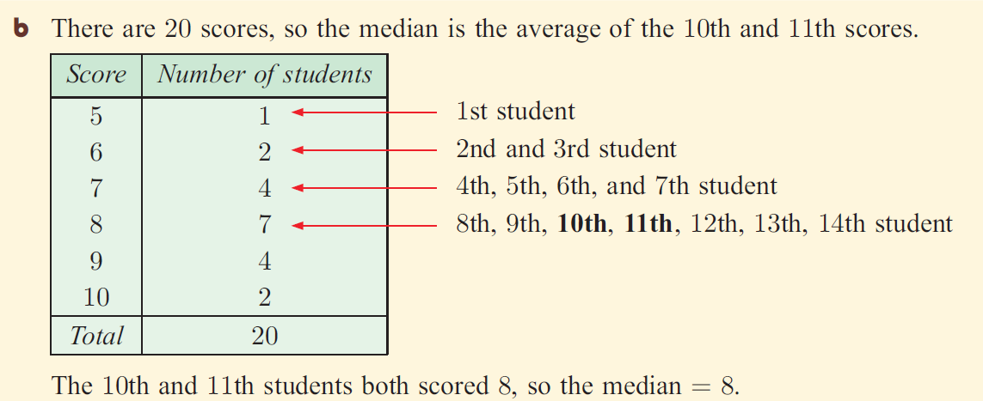
LO: TBAT calculate the averages from a frequency table.

Slide 6

Notes
Position of the median in a table:
Median = ${\frac{n+1 }{2 }}^{th}$
N = total frequency

Slide 7
Averages
Year 9 did a French test and their results are below. Calculate the median of the data.
Mark (out of 10) | Frequency
5 | 12
6 | 23
7 | 35
8 | 19
9 | 14
10 | 7
Total

Slide 8
LO: TBAT calculate the averages from a frequency table.

Slide 9

LO: TBAT calculate the averages from a frequency table and be able to

Slide 10
HAESE year 8 page 393-398 every second question

